Slide 1


E WASTE BIN
OPEN PROJECT’22
PROJECT REPORT

Slide 2
UNDER THE GUIDANCE OF MENTORS:
ABHAY
HARIKRISHNAN
SANJEEV KRISHNAN SIR
TEAM MEMBER
AASTHA TEMBHARE
JITESH BHATI
KAIVALYA
SHREYA MITTAL

Slide 3
ABSTRACT:
This project aims to deal with designing a dustbin which is able to weigh the waste and segregate the waste in respective compartment for different type of E-wastes .
This bin is specialized with ability to open itself when someone is in its proximity for taking the waste .

Slide 4
MOTIVATION:
The commercial challenge to recycle the e-waste is the availability of target recyclable waste . As common people don’t segregate the E-wastes from domestic wastes which reduces the opportunity to recycle these valuable waste and thus separately disposing e-wastes contributes to improvise the recycling value-chain . This reduces to large demand for virgin materials and increase mining process, which can be reduced by recycling .

Slide 5
WORKFLOW:
When person comes closer to the bin the proximity sensor detects and start other sensor like loadcell , etc .
Placing the waste and detecting the type of e-waste with the help of camera and opencv .Also display of weight of waste measured by loadcell .
After analysing the type of waste the input will be given according the type of waste to the Arduino code .
Arduino code based on input decides in which pit waste should be thrown and gives a command to stepper .
Stepper motor starts functioning and throws the waste in desired bin and also ultrasonic sensor placed below the plate will sense how much the bin is filled for each section .

Slide 6
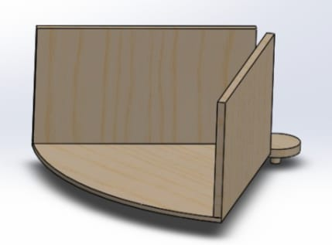
MECHANICAL ASPECT OF THE DESIGN:
1.bin:
THE BIN IS A STANDARD SIZED P.V.C. DUSTBIN WITH A CIRCULAR FACE OF DIAMETER 48CM ,HEIGHT 90CM.
2. PI SHAPED PANELS:
TWO PI-SHAPED PANELS WERE CUT OUT FROM THICK CARDBOARD. THEYARE HOLDING LOAD CELL BETWEEN THEM ATTACHED WITH NUT AND BOLTS,AND A SMALL SECTOR FROM THE LOWER PANELIS REMOVED WITH VEMTRES OF BOTH COINCIDING, AND THUS THE EMERGING PART OF THE UPPER PANE IS ATTACHED TO THE STEPPER MOTOR.

Slide 7
FLY WHEEL:
It was cut out from a wooden panel, the spikes are strengthened by attaching aluminium strips. The solid circle in the centre holds the stepper motor (which is rotating the Pi-shaped panel) along the central axis of the bin ,it works as a frame for cardboards used for inner partitioning in the bn and it also works as a base for the circular disk working as an upper lid.
This flywheel is placed on the top of the bin ,fixed by nuts and bolts.
Dimensions: Outer radius 30cm
Inner disc’s radius 8cm
Thickness of spikes 5cm

Slide 8
FLAP AND UPPER LID:
The upper lid which is a wooden circular disk (radius 30cm) is standing on the flywheel frame by five aluminium rods.
A Stepper motor is fixed on the centre of the lid along the central axis and its rotating part is holding the wooden flap .The height of lid so adjusted that it leaves a gap of 1cm between flap and pi panels.

Slide 9
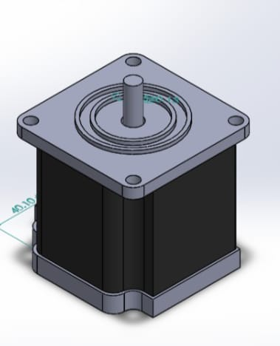
ELECTRONIC ASPECT OF DESIGN: 1.STEPPER MOTOR: The bin uses two 12 volt stepper motors,200 steps per rotation. These motors are controlled by L298n stepper drivers. Using stepper motor along with drivers provide rotations at required angles with precision at a faster speed ,increasing the accuracy of the bin and saving time consumed in motion.

Slide 10
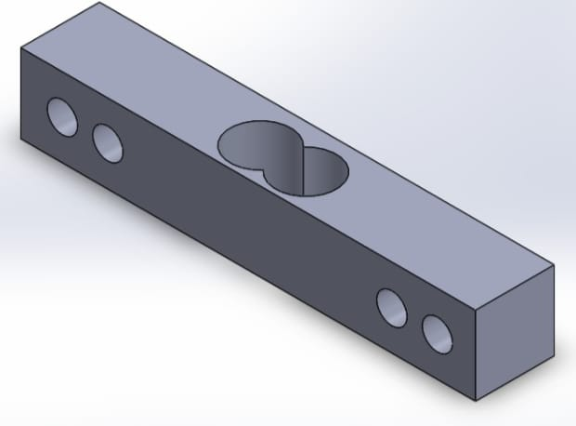
2. ARDUINO MEGA:
It has a large number of pins ,hence all the sensors and motors can be connected easily .
Can be used for years as,4kb of eeprom space available.
3. Loadcell & HX711:
We used 1kg loadcell with HX711 adc chip.
The strain gauge provides it a high precision ,it can measure very slight changes in weight making it suitable for light weight electronic waste like earphones.

Slide 11
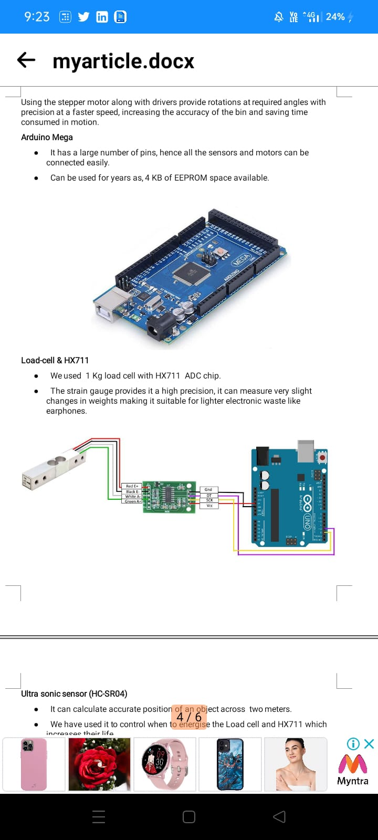

Slide 12
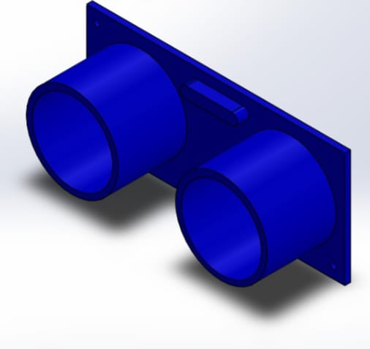
ULTRASONIC SENSOR(HC-SR04):
It can calculate accurate position of an object across two meters .
We have used it to control when to energise the loadcell and HX711 which increases their life.
OBJECT DETECTION:
Object detection is done by using ultralytics model based on YOLOv5 and Pytorch and is trained over the custom dataset.
YOLOv5 is one of the most high-performing object detectors out there .It is fast ,has high accuracy and is incredibly easy train.

Slide 13
COST STRUCTURE:
COMPONENTS | COSTS
IR PROXIMITY SENSOR | 100
WEBCAM | 500
ULTRASONIC SENSOR | 100
ARDUINO MEGA | 2000
STEPPER MOTOR(2) | 1000*2
LOAD CELL | 500
DUSTBIN | 700
Hx711 | 150
STEPPER DRIVERS[I298n](2) | 120*2
TOTAL- | 6290/-

Slide 14
APPLICATION:
The E-bin sort out different types of wastes and shows the cost of material proportional to its weight .
LIMITATIONS:
Can only be able to separate waste not according to type of material or component used in that e-waste but only according to the major categories of product like mouse, earphones, watch, charger and smartphone.

Slide 15
Needs a power supply nearby to operate .
The waste have to be taken out manually, which can be done by removing above setup of sensors and other settings.
Object detection is carried out on laptop.
If modified for segregating more categories of waste then consume large space more than a usual sized dustbin as used here.

Slide 16
FUTURE IMPROVEMENTS:
We can use raspberry pi to carry out image processing and object detection and can add some more sensors to carry out segregation on basis of recyclability making it more practical.
Can be applied with an reward-based mechanism to make it more appealing.

Slide 17
REFERENCES:
https://youtu.be/sxzoAGf1kOo
https://github.com/ultralytics/yolov5
https://github.com/heartexlabs/labelImg
https://github.com/nicknochnack/YOLO-Drowsiness-Detection
https://randomnerdtutorials.com/arduino-load-cell-hx711/
https://youtu.be/36Bry_57Pcc
https://youtu.be/r5Ntr4JcFqI
https://youtu.be/tFNJGim3FXw

